Slide 1
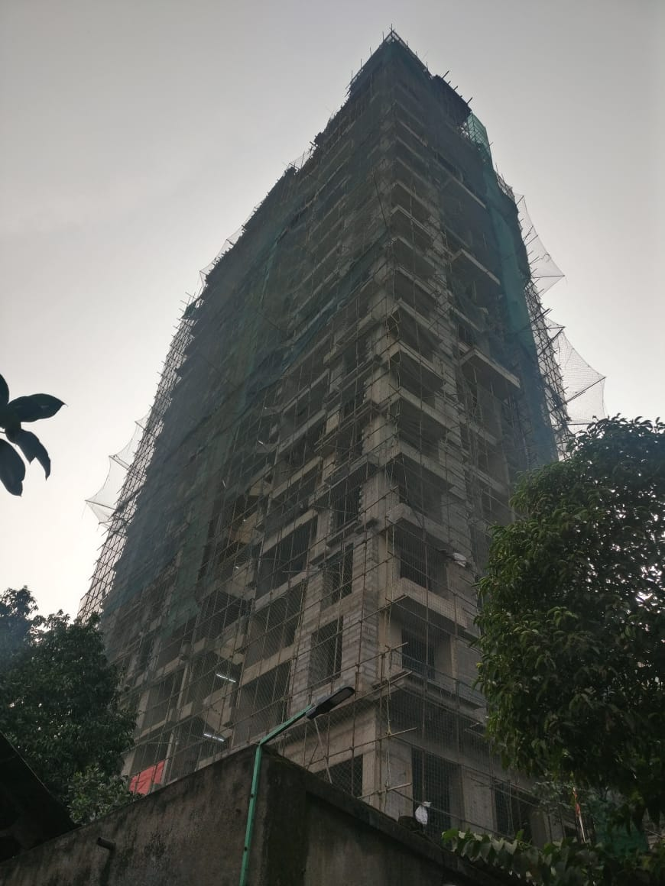
VIEW FROM ROAD SIDE

Slide 2
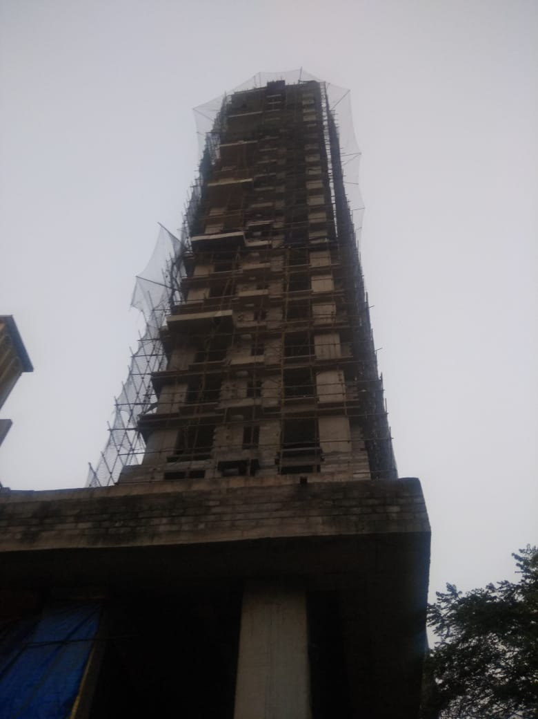
VIEW FROM BACK SIDE

Slide 3
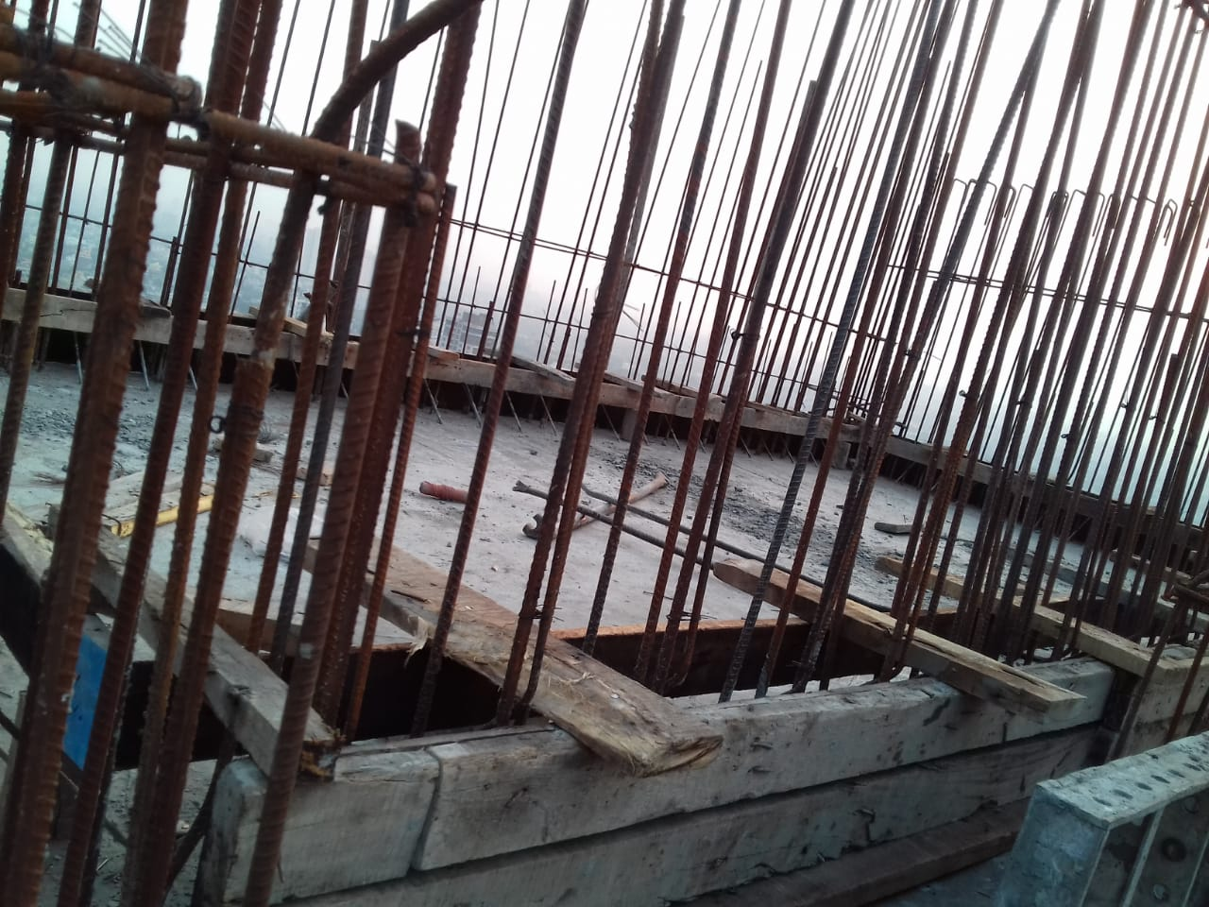
ABOVE TERRACE RCC WORK IN PROGRESS

Slide 4
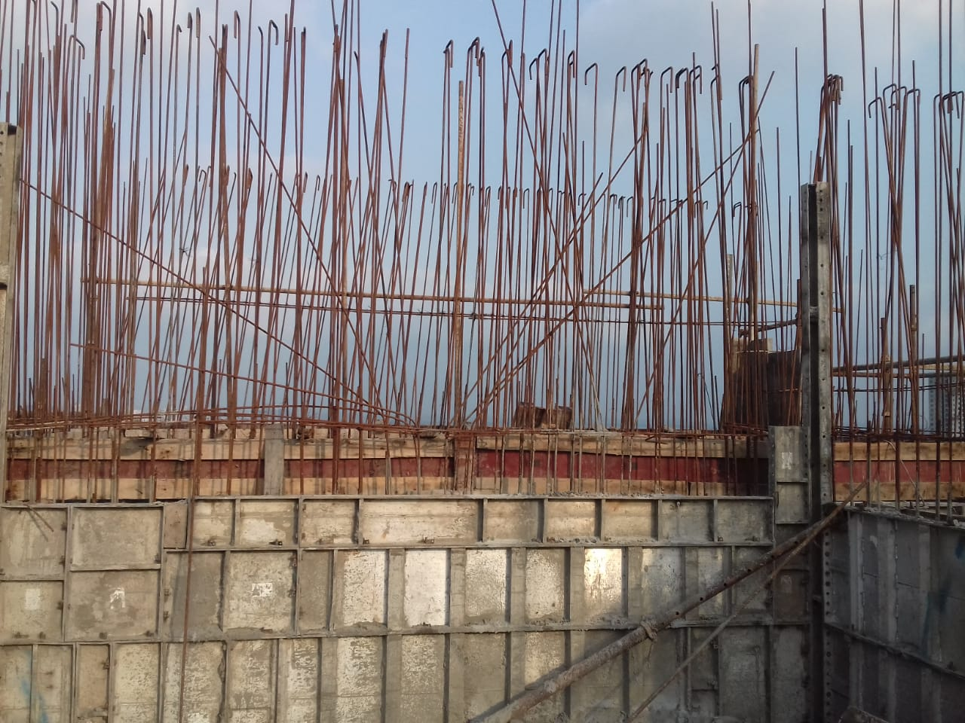
ABOVE TERRACE RCC WORK IN PROGRESS

